Slide 1
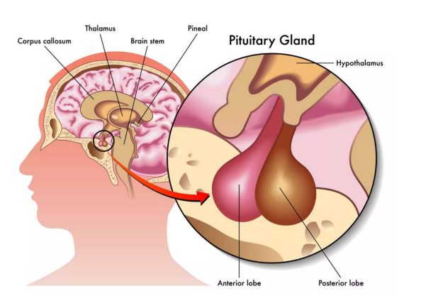
University of Baghdad
Nursing college
Pituitary Disorders
Prepared by : Khadija Mohammed Jassim
Supervisor : Prof. Dr. Sabah Ahmed

Slide 2
Pituitary disorders occur when the pituitary gland makes too much or too little of a particular hormone. Most often, these disorders are caused by a pituitary tumor.
Most pituitary tumors are noncancerous (benign). But when a tumor grows on or near the pituitary gland, the tumor can:
Change hormone production, leading to symptoms such as weight gain, stunted or excessive growth, high blood pressure, low sex drive or mood changes.
Press against the pituitary gland, optic nerves or brain tissue, causing vision problems or headaches.
2

Slide 3
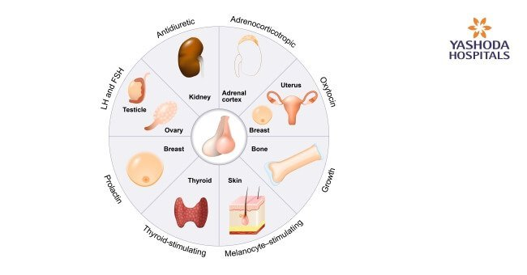
Functions of pituitary glands:
The pituitary gland produces many hormones that regulate bodily functions:
3

Slide 4
Causes of pituitary glands disorders
Tumor growth.
Head injury
Birth defects
Inherited genetic defects
Low blood supply to the pituitary gland
Previous history of pituitary disorders
Medication
Radiation therapy in the head and neck region
4

Slide 5
Disorders of Pituitary Gland :
Parts involved | Hyperactivity | Hypoactivity
Anterior pituitary | Gigantism Acromegaly Prolactemia Cushing’s disease Hyperthyroidism | Dwarfism Acromicria Hypothyroidism
Posterior pituitary | Syndrome of inappropriate hypersecretion of ADH (SIADH) | Diabetes insipidus
5

Slide 6
Gigantism &Acromegaly
Causes: increase production of growth hormone.
Signs and symptoms:
Very rapid growth.
Coarsening of facial features.
Enlargement of hands and feet.
High blood sugar.
Kyphosis.
6

Slide 7
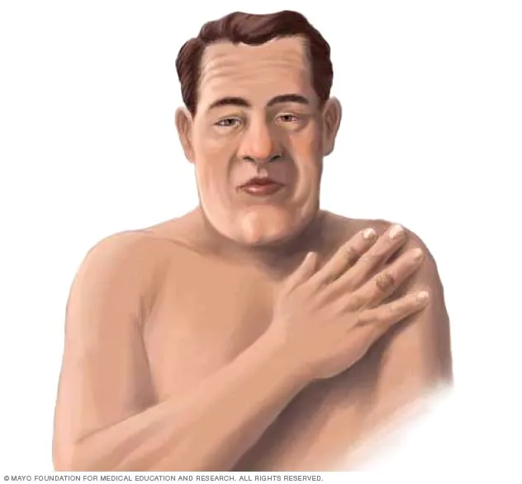
Diagnosis: specific blood and urine test.
MRI of the pituitary gland.
Management: slowing down excess hormone production by:
Taking medication.
Radiation therapy.
Surgery of the pituitary gland.
7

Slide 8
Prolactemia
Causes: increase production of prolactin hormone.
Signs and symptoms:
Delay in puberty.
Disruption of normal periods in female.
Milky discharge from the nipple.
8

Slide 9
Diagnosis: blood and urine test.
MRI of the brain.
Management: slowing down excess hormone production by:
Taking medication.
Surgery of the pituitary gland.
9

Slide 10
Cushing disease
Cushing disease (also called hypercortisolism) occurs when body makes too much cortisol, a hormone related to the body’s stress response.
Symptoms of Cushing disease:
Round, red face
Hump on back of neck
Purple stretch marks, especially on the chest, armpits and belly
Skin changes, such as acne, excessive facial hair and easy bruising
Unusual, rapid weight gain, especially around the belly
10

Slide 11
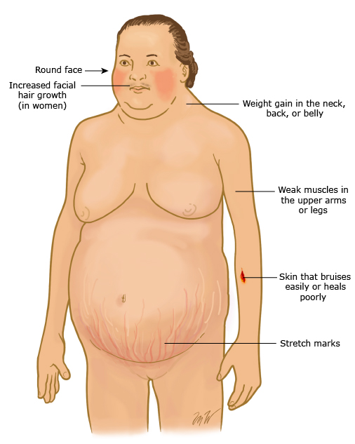
Diagnosis: Blood , urine tests and Late-night saliva test.
MRI, Abdominal CT scan.
Management:
Medications
Surgery
Radiation therapy
11

Slide 12
Hyperthyroidism
Thyroid gland makes too much thyroid hormone. This condition also is called overactive thyroid. Hyperthyroidism speeds up the body's metabolism.
Symptoms of Hyperthyroidism:
Losing weight without trying.
Tachycardia , Irregular heartbeat and heart palpitations.
Increased hunger.
Tremor.
Sweating.
12

Slide 13
Diagnosis: Medical history and physical exam.
blood tests, Radioiodine scan and uptake test.
Thyroid ultrasound.
Management:
Medications (Anti-thyroid medicine).
Surgery (Thyroidectomy).
Radioiodine therapy.
13

Slide 14
Dwarfism
Causes: decrease production of growth hormone.
Signs and symptoms:
Short stature.
Very slow growth rates.
Low muscle mass.
Low energy level.
14

Slide 15
Diagnosis: a detailed history of symptoms, Physical examination, blood and urine test, review of the growth chart and x ray to determine skeletal growth.
Management: hormonal therapy.
15

Slide 16
16

Slide 17
Causes: deficiency of growth hormone.
Signs and symptoms:
Atrophy and thinning of extremities.
Person become lethargic and obese.
Loss of sexual function.
17

Slide 18
Hypothyroidism
Causes: decrease of thyroid stimulating hormone.
Signs and symptoms:
Fatigue .
Dray skin, brittle hair.
Constipation .
Poor growth.
Diagnosis: history of symptoms, Physical examination, blood and urine test.
Management: hormonal therapy.
18

Slide 19
19

Slide 20
20

Slide 21
Diagnosis: Physical examination, blood and urine test
Management:
Limit fluid intake.
Medication.
Surgery
21

Slide 22
22

Slide 23
Causes: decrease ADH production.
Diagnosis: water deprivation test, MRI.
Management:
Hormonal replacement therapy.
Medication to make ADH more available in the body.
Increase intake of fluid.
23

Slide 24
Care of Patients with Pituitary Gland Problems
1. Protect the patient with antidiuretic hormone (ADH) deficiency from dehydration.
2. Use appropriate interventions to prevent injury in the patient who has hypercortisolism.
3. Teach patients how to avoid increasing intracranial pressure after pituitary surgery.
4. Teach patients how to monitor therapy effectiveness for diabetes insipidus or syndrome of inappropriate ADH (SIADH).
24

Slide 25
25

